Slide 1
CS5573 Introduction to Information Security and Assurance Ethical Hacking - Reconnaissance
Instructor: Mahesh Maddumala

Slide 2
Footprinting
Footprinting is defined as the process of creating a blueprint or map of an organization’s network and systems.
This is also referred to as the documentation phase because it collects required information about the target.
Information gathering includes collecting,
Organization’s information – background of the organization, websites, addresses, phone numbers, emails, employee details, working hours, etc.
Organization’s network information – mapping the network, network topology, network blocks and IP addresses, Firewalls and IDS/IPS, VPN, etc.

Slide 3
Network Footprinting - Whois
Whois: This utility searches the Internet for domain name administration details, such as domain ownership, address, location, phone number, and so on, about a specific domain name.
Operating System utilities – whois (Linux and Windows)
Online tools:
http://www.whois.com/
https://www.networksolutions.com/
Mobile Tools.

Slide 4
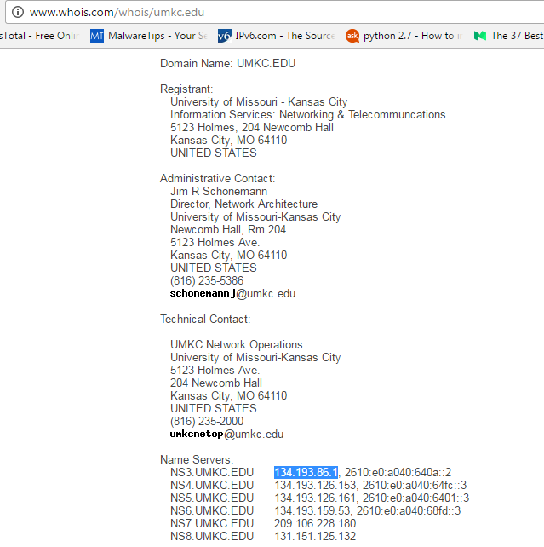
http://www.whois.com/whois/ output for umkc.edu

Slide 5
Network Footprinting - Whois
There are five Regional Internet Registries (RIR) that oversee public IP addresses within their geographic regions and allows Whois-type searches on their databases. These are:
American Registry for Internet Numbers (ARIN): North America
RIPE Network Coordination Centre (RIPE NCC): Europe, the Middle East and Central Asia
Asia-Pacific Network Information Centre (APNIC): Asia and the Pacific region
Latin American and Caribbean Internet Address Registry (LACNIC): Latin America and the Caribbean region
African Network Information Centre (AfriNIC): Africa

Slide 6
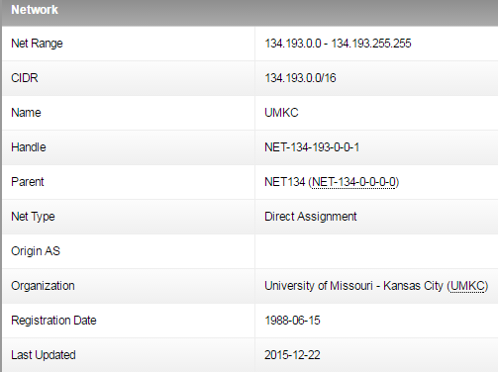
Entering the IP address of the target's web server into ARIN's Whois (www.arin.net) will identify the number and range of IP.
whois.arin.net output for 134.193.86.1

Slide 7
Network Footprinting - Nslookup
Nslookup is a program to query Internet domain name servers for record information.
It displays information that can be used to identify the target's Domain Name System (DNS) infrastructure by querying DNS servers for machine name and address information.
Both the Linux and Windows operating systems come with an Nslookup client.

Slide 8
Website Footprinting
Website technical details and statistics
Operating system (eg: Windows Server 2008)
Software (eg: Apache)
Subdomains
Sub-directories and parameters
Databases
Scripting platforms
Website traffic details
Website reputation
Mirroring entire website
Web spiders

Slide 9
Website Footprinting - Tools
Website technical details and statistics - www.netcraft.com
Website mirroring - www.surfoffline.com
Website archives – www.archive.org

Slide 10
Other Footprinting Tools
Maltego - This tool is used in online investigations for finding relationships between pieces of information from various sources located on the Internet.
Recon-ng – Web reconnaissance framework.
Social Network sites.

Slide 11
Social Engineering
Computer-based
Email attachments
Phishing
Online scams
URL obfuscation
Human-based
Eavesdropping
Shoulder surfing
Dumpster diving
Impersonation
Calling technical support

Slide 12
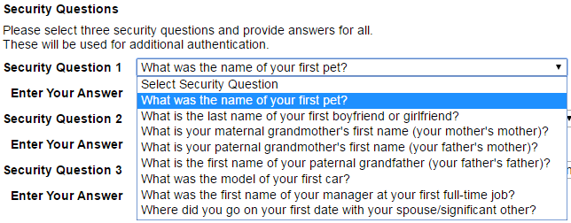
Security Questions

Slide 13
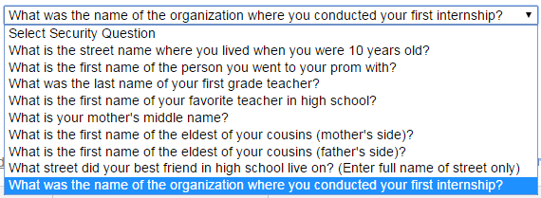
Security Questions

Slide 14
References
Kevin M. Henry. Penetration Testing: Protecting Networks and Systems. IT Governance Ltd.
Kimberly Graves. Certified Ethical Hacker study guide. Sybex.
https://www.paterva.com
https://en.wikipedia.org

